Slide 1
MGMT590 - Visual Analytics
Session 2
Dr. Cecilia Ying
Updated: 08/26/2025

Slide 2
Today’s agenda
Session 2: Foundations of Data Visualization
Introduction to Visual Analytics
Descriptive Analytics
Code Demo
Business Applications
Assignment 1 Details

Slide 3
Special Announcement
Bonus marks – Here’s a “special” graph
5 mins show and tell of a “special” graph
What makes it “special”?
It’s really good: Why is it good? What information is being communicated?
It’s really bad: Why is it bad? What would you change to improve it?
It’s really cool: Why is it cool? Where else can you use this type of graph?
Flex your managerial muscles and get ready to critique

Slide 4
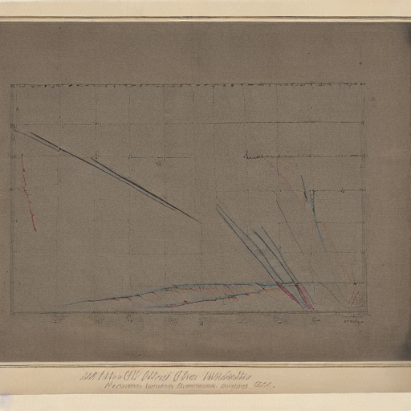
Here’s an example
Just a terrible graph
Why is this terrible?
How was this made?
Randomly generated
using Stable Diffusion
Prompt: “a graph, in color, similar to the ones William Playfair created”

Slide 5
Introduction: Visual Analytics

Slide 6
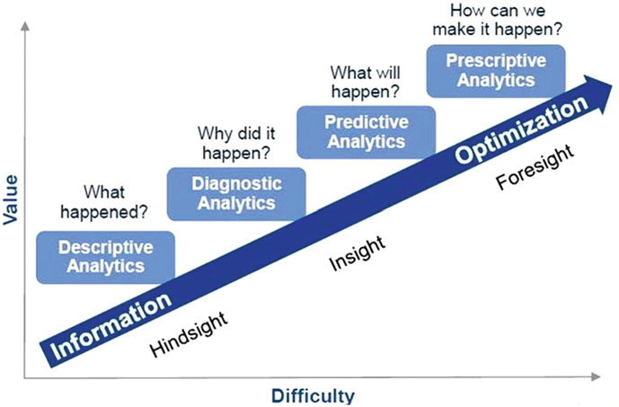



Stages of Analytics
Descriptive, Diagnostic, Predictive and Prescriptive
Machine Learning Models
Artificial Intelligence
Automating the decision-making based on predictions
Data Visualization

Slide 7

Descriptive Analytics
What happened?
Examines historical data to identify trends, patterns, and correlations, providing insights into what happened.
Sales Analysis: Analyzing monthly sales data to identify top-selling products, revenue trends, and seasonal fluctuations.
Customer Segmentation: Analyzing customer data, such as demographics, purchase history, and behavior, to identify distinct customer segments and tailor marketing strategies.
Website Traffic Analysis: Examining website traffic metrics, such as page views, bounce rates, and user demographics, to understand user behavior and engagement.

Slide 8

Diagnostic Analytics
Why did it happen?
Examines historical data to identify the root causes of problems or events, providing insights into why certain events occurred.
Root Cause Analysis: Analyzing production data to identify the causes of equipment failures or quality control issues.
Customer Churn Analysis: Examining customer data to determine the reasons behind customer churn, such as poor service or product dissatisfaction.
Supply Chain Disruption Analysis: Investigating data to identify the causes of supply chain disruptions, such as supplier insolvency or logistics issues.

Slide 9

Predictive Analytics
What will happen?
Uses statistical models and machine learning algorithms to forecast future events or outcomes, providing insights into what may happen.
Demand Forecasting: Using historical sales data and seasonal trends to predict future demand for products.
Credit Risk Assessment: Analyzing customer credit data to predict the likelihood of loan defaults.
Predictive Maintenance: Using sensor data and machine learning algorithms to predict equipment failures and schedule maintenance.

Slide 10

Prescriptive Analytics
How can we make it happen?
Provides recommendations on actions to take to achieve a specific goal or outcome, providing insights into what should be done.
Optimal Pricing: Analyzing market data and customer behavior to determine the optimal price for a product.
Resource Allocation: Using optimization algorithms to allocate resources, such as personnel or equipment, to maximize efficiency.
Personalized Recommendations: Providing personalized product recommendations to customers based on their purchase history and behavior.

Slide 11
Descriptive Analytics
“In this world of big data, data literacy—the ability to analyze, interpret, and even question data—is an increasingly valuable skill.” - Prof. Jan Hammond, HBS
Use of data visualization
1. Identifies trends and correlations
2. Enhances data interpretation
3. Increases engagement and comprehension
4. Communicates complex data effectively
5. Improves decision-making
We will go beyond 2D graphs and charts!
Most important!!!
So that we don’t get replaced by AI
Finding meaning in multi-dimensional data
“A picture is worth a thousand words”

Slide 12
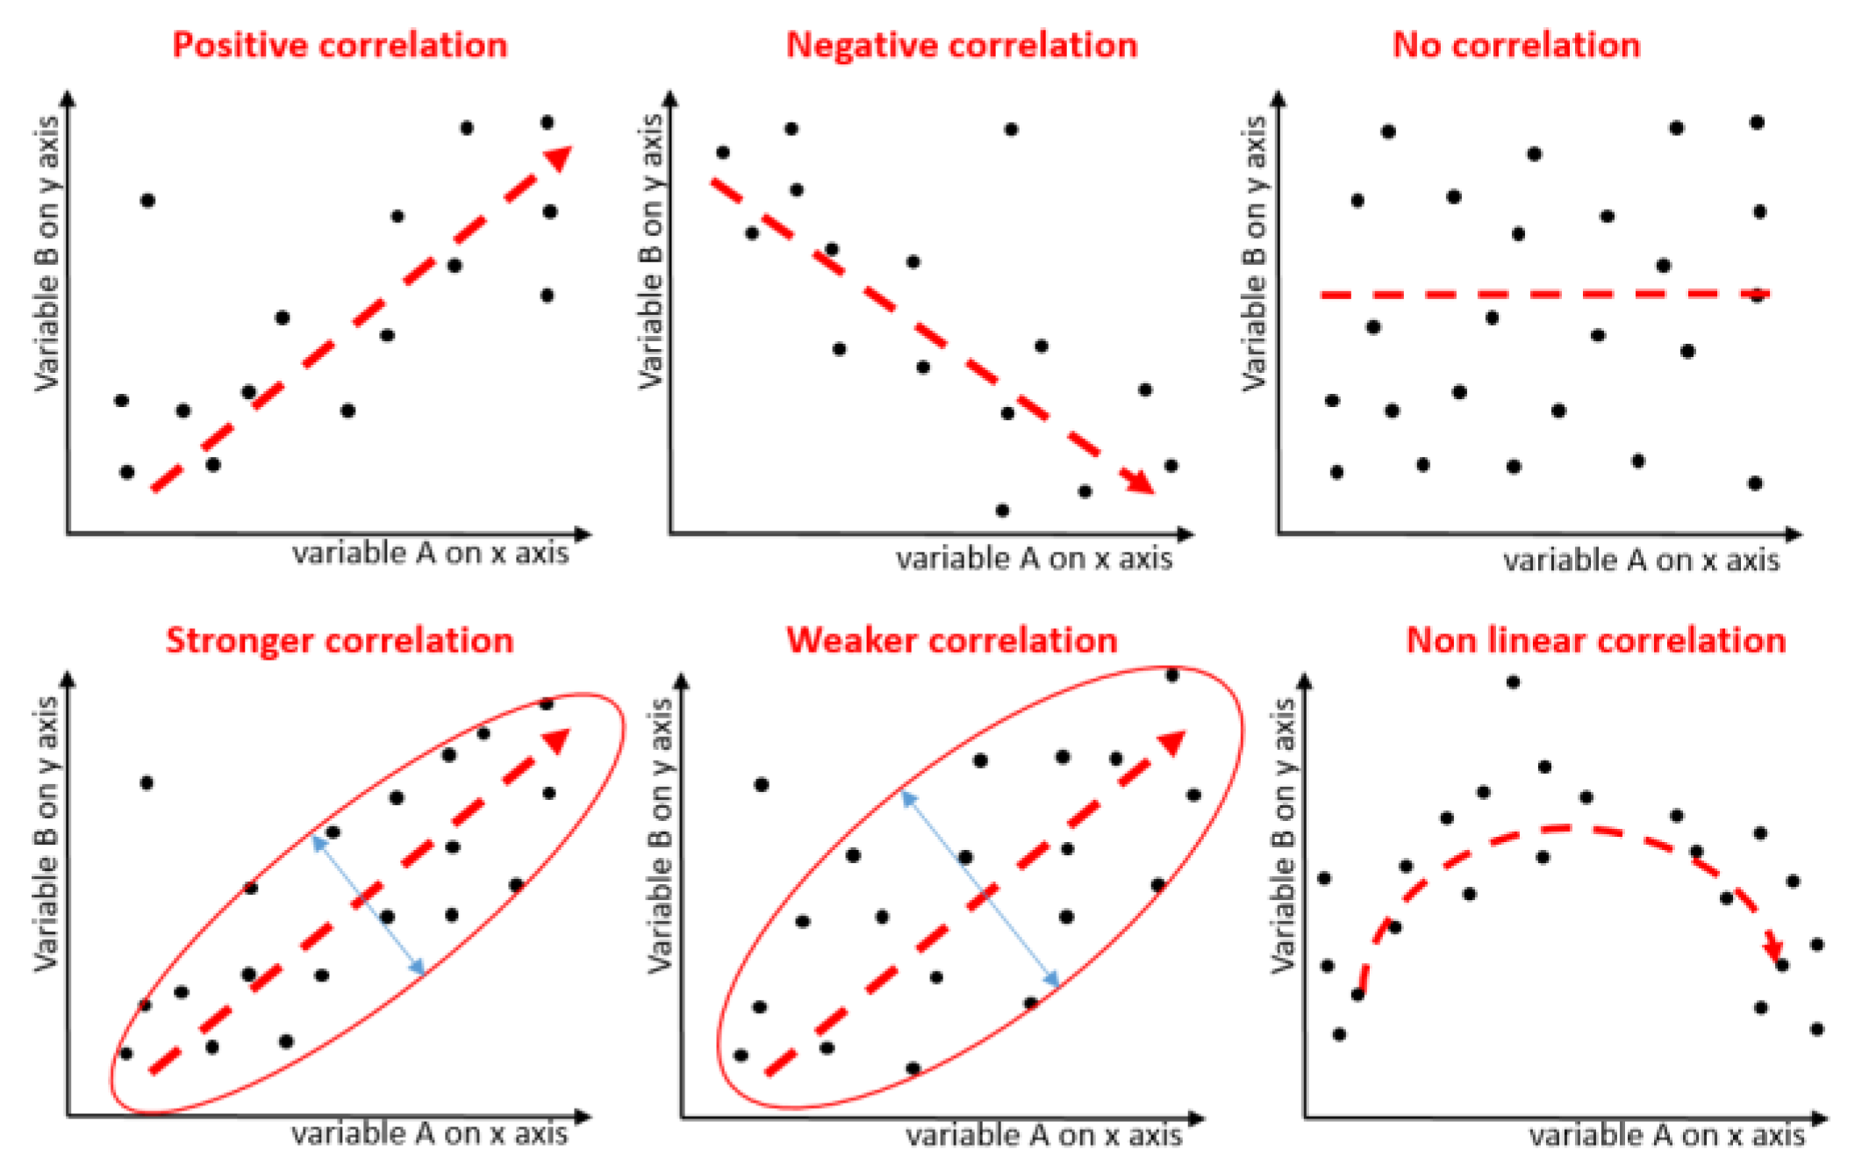
1. Identify trends and correlations
Positive, negative, or no correlation?
Note: Use of unsupervised ML for clustering
To find similarity in high dimensional data

Slide 13
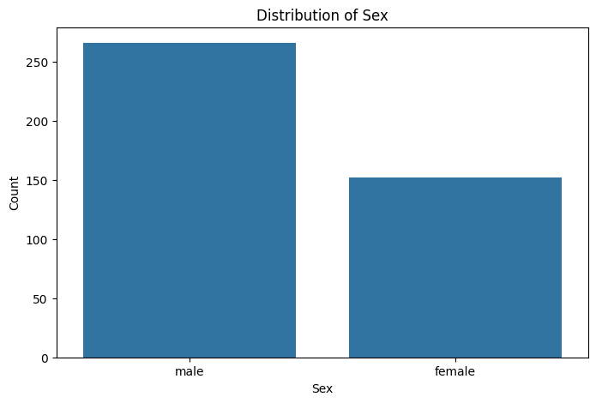
Enhance data interpretation
Are there more male than female passengers?

Slide 14
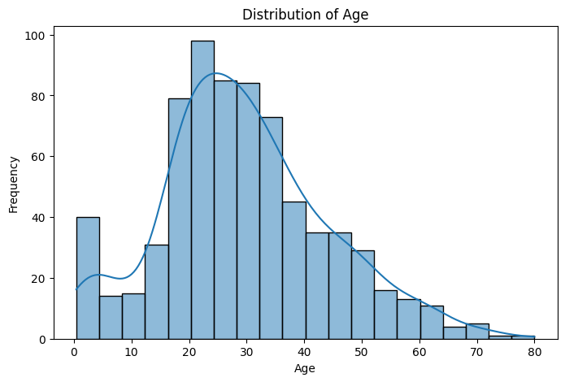
Increase engagement
What can we do with this information?

Slide 15
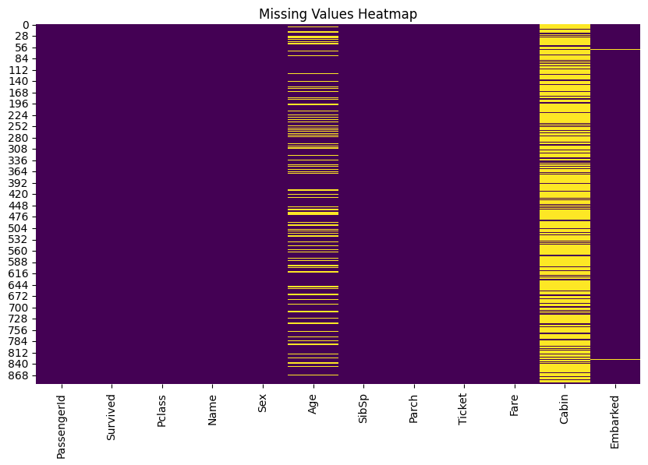
Communicate complex data effectively

Slide 16
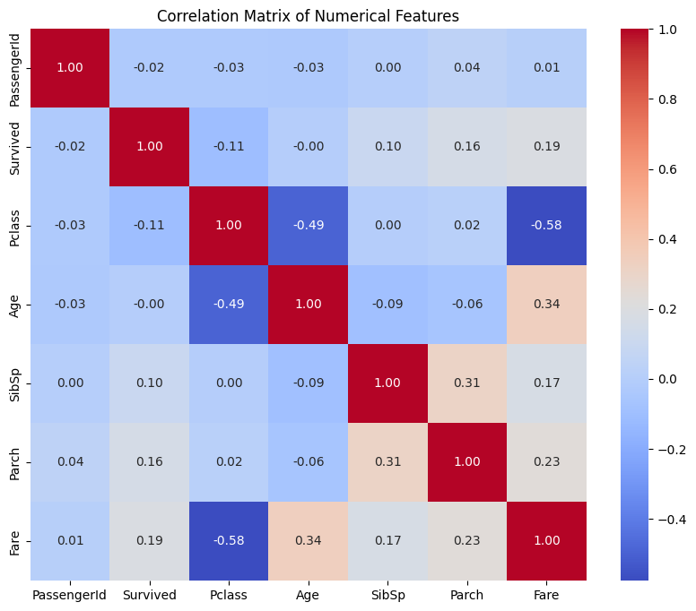
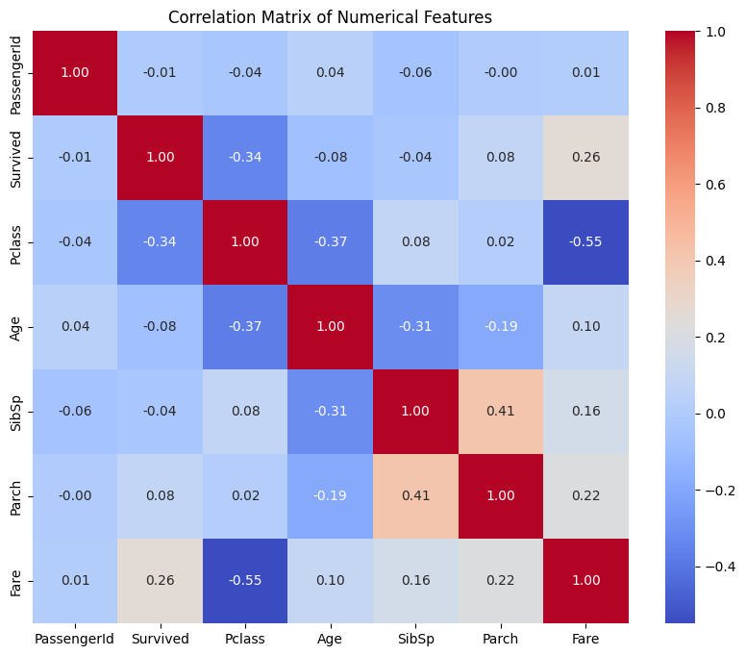

Slide 17
Improve decision-making
This is where YOU come in
Despite $30–40 billion in enterprise investment, only 5% of organizations achieve measurable ROI, while 95% remain stuck with stalled pilots and no P&L impact. ​
MIT (Project NANDA) Report
The GenAI Divide: State of AI in Business 2025

Slide 18
Descriptive Analytics
A picture’s worth a thousand words

Slide 19
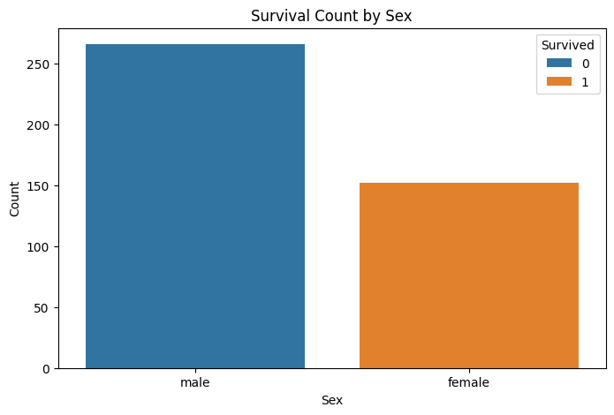
A picture’s worth a thousand words
What is this picture telling us?

Slide 20
Exploratory Data Analysis – EDA
Gemini’s plan
Inspect the data: Display the first few rows, column names, data types, and summary statistics of the data.
Check for missing values: Identify and visualize missing values in the data.
Analyze distributions: Visualize the distributions of numerical and categorical features.
Explore relationships: Analyze the relationships between different features, particularly with the 'Survived' column.
Identify outliers: Detect and visualize outliers in numerical features.
Summarize findings: Provide a summary of the key findings from the EDA.
Finish task: End the analysis and present the findings.

Slide 21

Code Demo –
https://colab.research.google.com/drive/1RGBZDpBvwLqhZZGahvAOxenRAVopQWht?usp=sharing

Slide 22

Human still makes the call
This is where YOU come in…

Slide 23
Assignment 1
Titanic – who will survive?

Slide 24
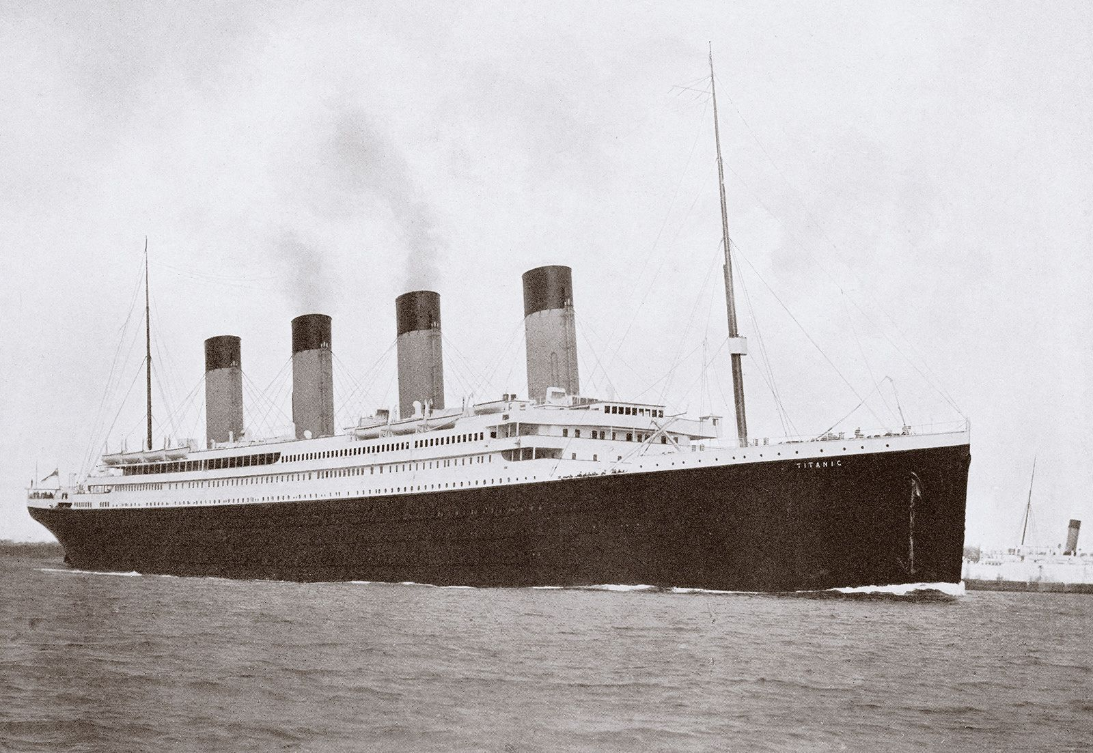
Titanic
Finding insights from the data
Data Understanding & Preparation
Assess the quality of the data
Create a plan to address (through data engineering)
Potentially incorrect data
Missing data
Collection of additional data that might be useful
Decision-making
Given the data you have and the understanding of who is more likely to survive, what else could be done to improve the survival rate?
Obviously, other than “adding more lifeboats”

Slide 25
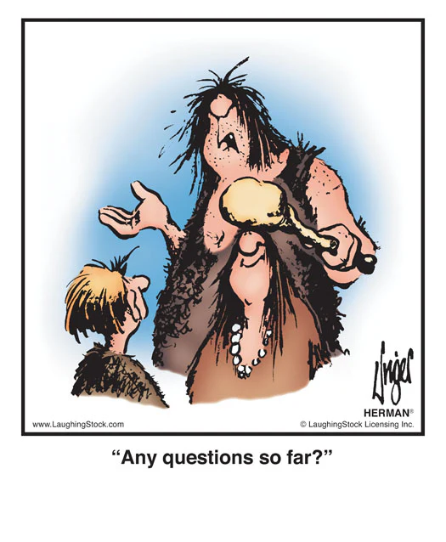
Questions?

Slide 26
Team Project
Team set up and project brainstorming

Slide 27
Team Project
First, create a group
4-5 people
Select a cool team name
Enroll yourself in the group on Brightspace
Brainstorm
What problems are you trying to solve?
What questions are you trying to answer?
What kind of data will you need?
Do this by
Sept. 7th

Slide 28

That’s a wrap

Slide 29
Course Schedule
At a glance

